Slide 1
MATHEMATICAL FOUNDATION FOR COMPUTER SCIENCE
Prepared by: Er. Ankit Kharel
Nepal college of information technology

Slide 2
Finite state automata
• Sequential Circuits and Finite state Machine
• Finite State Automata
• Non-deterministic Finite State Automata
• Language and Grammars
• Language and Automata
• Regular Expression

Slide 3
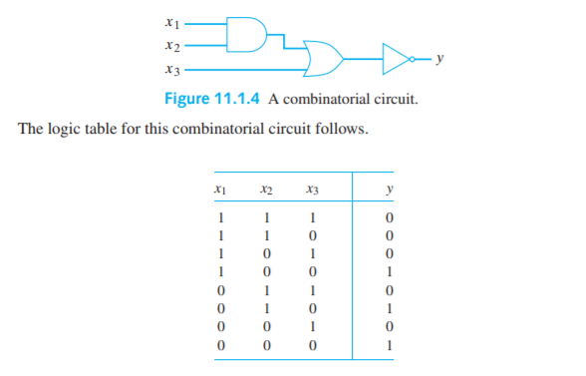
Combinational circuits:
Combination circuit is a circuit where the output depends only on the present value of input. Combinatorial circuits can be constructed using solid-state devices, called gates.
A combinatorial circuit has no memory; previous inputs and the state of the system do not affect the output of a combinatorial circuit.

Slide 4
Sequential circuits:
Sequential circuit is a circuit where the output depends on the present value of input as well as the sequence of past input.
A Sequential circuit is a combination of combinational circuit and a storage element.
The sequential circuits use current input variables and previous input variables which are stored and provides the data to the circuit on the next clock cycle.
Inputs
Combinational circuit
Outputs
Memory
Fig. Sequential circuit

Slide 5
Sequential circuits:
We will assume that the state of the system changes only at time t = 0, 1,... . A simple way to introduce sequencing in circuits is to introduce a unit time delay.
A unit time delay accepts as input a bit x_{t} at time t and outputs x_{t−1}, the bit received as input at time t − 1.
The sequential circuits use current input variables and previous input variables which are stored and provides the data to the circuit on the next clock cycle.
As an example of the use of the unit time delay, we discuss the serial adder.
x_{t}
Delay
x_{t−1}
Fig. Unit time delay

Slide 6
Serial adder:
A serial adder accepts as input two binary numbers
x = 0x_{N}x_{N−1} ··· x₀ and y = 0y_{N}y_{N−1} ··· y₀ and output s the sum as:
Z = z_{N+1}z_{N} ···z₀
Example: x = 1011 (x₃x₂x₁x₀)
+ y = 0101 (y₃y₂y₁y₀)
z = 10000 (z₄z₃z₂z₁z₀)
The numbers x and y are input sequentially in pairs, x0, y0;...; x_{N}, y_{N}; . The sum is output z₀,z₁,...,z_{N+1}.
x_{t}
Full
Adder
z_{t}
y_{t}
c_{t}
C_{t-1}
Delay
Fig. Serial adder circuit

Slide 7
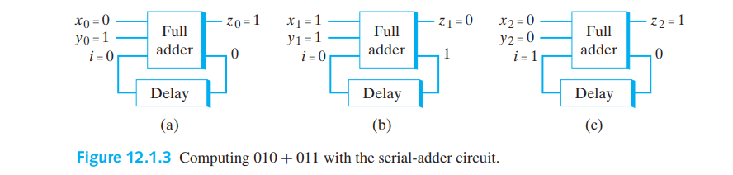
Serial adder:
Addition of x = 010 , y = 011.
First, we give input as x₀ = 0 and y₀ = 1 to the full adder. The adder computes z₀= (0+1)1 and sends 0 as carry to the delay.
Second, we give input as x₁ = 1 and y₁ = 1 to the full adder. Now, the delay sends the input 0 and the adder sums z₁ = (1+1+0) 0 and carry 1 is send to the delay.
Third, we give input as x₂ = 0 and y₂ = 0 to the full adder. Now, the delay sends the input 1 and the adder sums z₁ = (0+0+1) 1 and carry 0 is send to the delay.
Finally , the output is : z=x+y=101

Slide 8
Finite state machine:
A finite state machine is a model of computation based on a hypothetical machine made of one or more states. It is used to simulate sequential logic and some computer program.
We have a fixed set of states that machine can be in.
The machine can only be in one state at a time.
Every state has a set of transition and every transition is associated with an input and pointing to a state
Example:
TRAFFIC LIGHT:
A simple traffic light system can be modeled with a finite state machine. Let’s look at each core component and identify what it would be for traffic light.
a) States: A traffic light generally has three sates: RED, GREEN and YELLOW.
b) Initial state: GREEN(suppose)
c) Accepting state: In real world traffic lights run indefinitely, so there would be no accepting sate for this.

Slide 9
Finite state machine:
Example:
TRAFFIC LIGHT:
A simple traffic light system can be modeled with a finite state machine. Let’s look at each core component and identify what it would be for traffic light.
a) States: A traffic light generally has three sates: RED, GREEN and YELLOW.
b) Initial state: GREEN(suppose)
c) Accepting state: In real world traffic lights run indefinitely, so there would be no accepting sate for this.
d) Alphabets: Positive integer representing seconds
e)Transition:
If we are in state GREEN, wait for 360s and then go to state YELLOW
If we are in state YELLOW, wait for 10s and then go to state RED
If we are in state RED, wait for 120s and then go to state GREEN

Slide 10
YELLOW
360s
10s
GREEN
RED
120s
Fig: Transition diagram

Slide 11
Finite state machine:
Formal Definition of Finite State Machine(FSM)
A finite-state machine is an abstract model of a machine with a primitive internal memory. A finite-state machine M consists of
(a) A finite set I of input symbols.
(b) A finite set O of output symbols.
(c) A finite set S of states.
(d) A next-state function f from S × I into S.
(e) An output function g from S × I into O.
(f) An initial state σ ∈ S.
We write M = (I, O, S, f, g, σ)

Slide 12
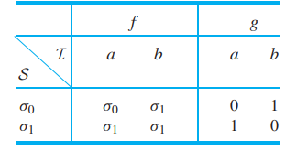
Finite state machine:
Let, I = {a, b}, O = {0, 1}, and S = {σ₀, σ₁}. Define the pair of functions f : S×I → S and g: S × I → O by the rules given in Table.
Solution:
(a) State Transition Function(STF): (b) Machine Function(MF)
f(σ0, a) = σ0 g(σ0, a) = 0 f(σ0, b) = σ1 g(σ0, b) = 1 f(σ1, a) = σ1 g(σ1, a) = 1
f(σ1, b) = σ1 g(σ1, b) = 0.
The next state Function and Output function can also be defined by the Transition
Diagram.

Slide 13
a/0
a/1
b/1
σ0
σ1
b/0
Fig: Transition diagram
Definition: Let M = (I, O, S, f, g, σ) be a finite-state machine. The transition diagram of M is a digraph G whose vertices are the members of S. An arrow designates the initial state σ. A directed edge (σ1, σ2) exists in G if there exists an input i with f(σ1, i) = σ2. In this case, if g(σ1, i) = o, the edge (σ1, σ2) is labeled i/o

Slide 14
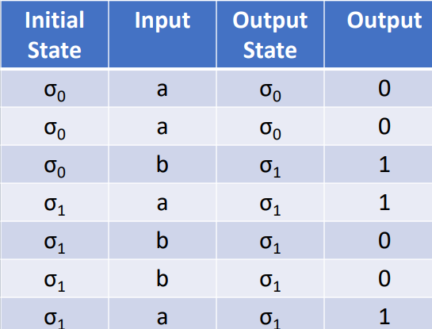
Finite state machine:
Find the output string corresponding to the input string “aababba” for below finite-state machine.
Solution:
The Output is:
0011001

Slide 15
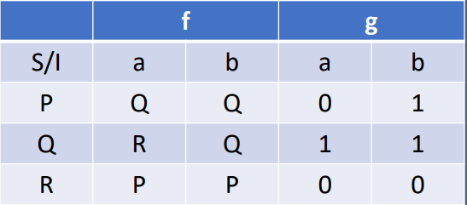
Finite state machine:
Draw the transition diagram of the finite state machine M, where, I = {a, b} O = {0, 1} S = {P, Q, R} σ = P and transition given by below table. Find the output string corresponding to the input string “aabbaba”
Solution:
Initial State | Input | Output State | Output
P | a | Q | 0
Q | a | R | 1
R | b | P | 0
P | b | Q | 1
Q | a | R | 1
R | b | P | 0
P | a | Q | 0
b/0
b/1
a/0
a/1
P
Q
R
b/1
a/0
Output: 0101100

Slide 16
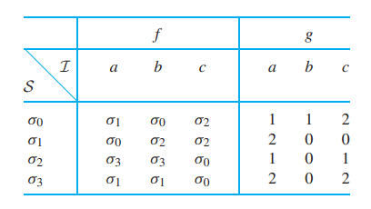
Finite state machine:
Draw the transition diagram of the finite state machine M, where, I = {a, b, c} O = {0, 1, 2}
S = {σ₀, σ₁, σ₂ , σ₃}, σ = σ₀ and transition given by below table. Find the output string corresponding to the input string “aabaab”
Solution:
c/1
c/2
σ₀
a/1
σ₁
b/0
a/1
σ₂
σ₃
a/2
b/1
c/0
b/0
a/2
b/0
c/2

Slide 17
